Slide 1
SCENARIO ANALYSIS
Who Watches the Watchers?
A scenario analysis of surveillance data: who owns it, whether it punishes what you did or predicts what you will do.
Owen Barlett, Jonathan Locala, Jason Jiang, Sylvia Yam
Notes:
Domain: surveillance technology and personal data. Axes: government vs. private ownership, and after-the-fact enforcement vs. prediction.

Slide 2
BACKGROUND
Surveillance went from a police tool to a national data network
What changed in the last five years
100,000+
2021: license-plate readers (ALPRs) were a specialized police tool. VC-funded Flock Safety made them a default purchase for small cities, HOAs and retailers.
Data became shareable across agencies in one click, then reachable by federal immigration enforcement. A local traffic tool became a national tracking network.
Real-time crime centers now fuse plate, camera and gunshot data; drone-as-first-responder programs have launched.
A private layer grew alongside it: data brokers sell phone locations, and AI chatbots now hold people's most intimate conversations.
Backlash crossed party lines: cities are canceling contracts, and residents are physically removing cameras.
Flock cameras deployed across the U.S.; 800 new city contracts approved in 2026 alone
3,500
police "wellness checks" triggered by Facebook's suicide-prediction AI in its first year
1.6 million
searches of San Francisco's plate data by federal and out-of-state agencies in 7 months
Sources: TechTimes, "Flock Safety Crosses 100,000 Cameras as 53 Cities Cancel," Jun 29, 2026; NPR, "Why some cities are canceling Flock license plate reader contracts," Feb 17, 2026; NPR, "Facebook Increasingly Reliant on A.I. to Predict Suicide Risk," Nov 17, 2018.

Slide 3
BACKGROUND
Surveillance is everywhere. Accountability is not.
Government-side vendors
Buyers
Private data holders
Pushback and courts
~18,000 U.S. police agencies, HOAs, retailers, schools, and federal agencies (FBI, ICE) that buy location data from brokers
Data brokers (Kochava), carmakers (GM OnStar), face-scanning stores (Wegmans, Walmart, Kroger), Amazon Ring, AI chat platforms
ACLU, EFF, DeFlock.org, the FTC; Carpenter v. U.S. (2018) requires a warrant to demand phone location data, not to buy it
Flock Safety (plate readers, drones), Motorola (Vigilant), Axon (Fusus crime centers), SoundThinking (ShotSpotter), Clearview AI (face ID)
The defenders' case
The chilling effect
Weak signals
Flock says its cameras aided 1M+ investigations and helped find nearly 10,000 missing people in 2025.
Watched people self-censor: Wikipedia views of terrorism-related articles fell after the 2013 Snowden leaks.
53 cities canceled or rejected Flock. Rite Aid was banned from face ID after false matches.
Sources: NPR, "Your data is everywhere. The government is buying it without a warrant," Mar 25, 2026; CNN, "Wegmans is scanning your face at some stores," Jan 12, 2026; FTC, GM/OnStar order, Jan 2026; FTC, Rite Aid order, Dec 19, 2023; Penney, Berkeley Tech. Law Journal 31(1), 2016; Carpenter v. U.S., 585 U.S. 296 (2018); TechTimes, Jun 29, 2026.

Slide 4
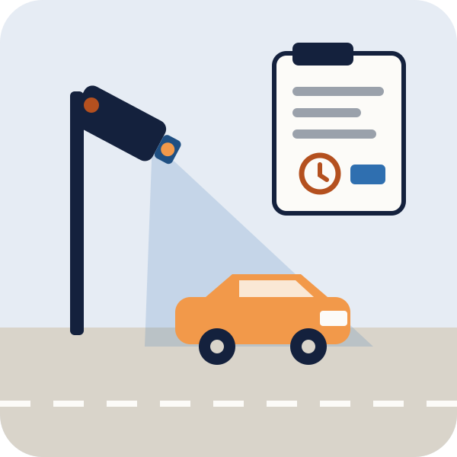
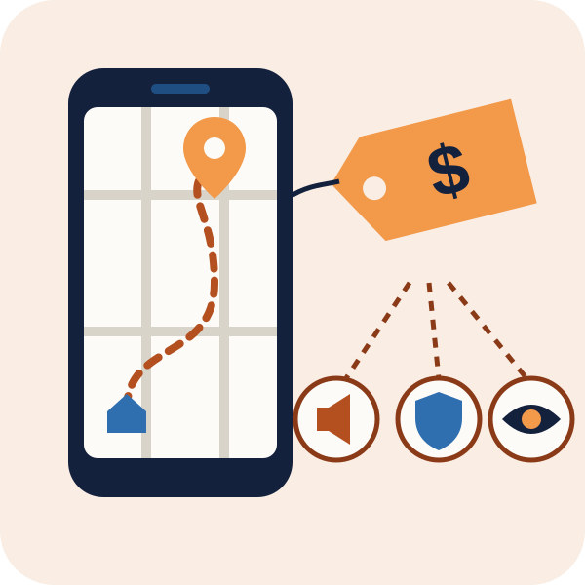
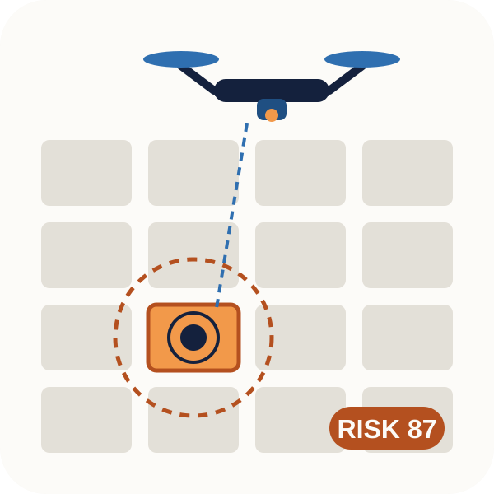
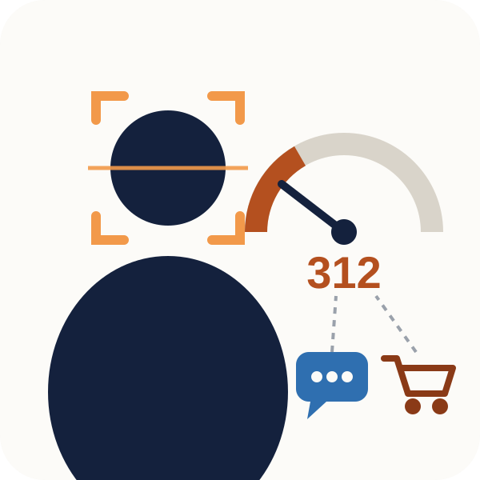
Four futures for surveillance data
▲ USED TO ENFORCE · AFTER
1 · GOVERNMENT × ENFORCE
2 · PRIVATE × ENFORCE
The Digital Witness
Your Routine for Sale
Every trace is kept as evidence, and AI "lie detectors" help decide guilt.
Companies learn your routine and sell it to advertisers, insurers, even stalkers.
Discomfort 2/5
◀ GOVERNMENT
PRIVATE ▶
3 · GOVERNMENT × PREDICT
4 · PRIVATE × PREDICT
The Pre-Crime State
The Scored Citizen
Police act on risk scores: drones follow flagged people, stops happen without evidence.
Company scores from chats, faces and purchases decide access and can bring police.
▼ USED TO PREDICT · BEFORE
Notes:
X-axis: who owns the data (government vs. private). Y-axis: when it is used (after the fact to enforce punishment vs. before, to predict). Discomfort is our own rating of how little power a person has to see, question or escape the system; the two bottom quadrants get the deep dives.

Slide 5
SCENARIO ANALYSIS · FOUR FUTURES SIDE BY SIDE
The further down and right, the less power you have
1 · Gov · Enforce
2 · Private · Enforce
3 · Gov · Predict
4 · Private · Predict
The Digital Witness
Your Routine for Sale
The Pre-Crime State
The Scored Citizen
Every plate read and phone ping is kept as evidence; AI "lie detectors" score interviews
Apps, cars and doorbells learn your routine and sell it to whoever pays
Police act on risk scores before any crime; drones follow the flagged
Companies score you from chats, faces and purchases; scores decide access
How it differs from today
You drove past a crime scene; weeks later you must prove where you were
You visit a clinic; your insurer reprices you, and an ex knows your schedule
Your block is flagged "hot"; you're stopped for a score, not an act
You tell an AI chatbot you feel like ending it; police arrive within the hour
A day in this future
Who you can appeal to
A judge, with a lawyer and rules of evidence
The FTC, years later, if it acts
A court, but only after the stop, arguing with a model
No one: no notice, no warrant, no right to dispute
Notes:
Read across each row: same questions for every future, so the four scenarios stay parallel.

Slide 6
DEEP DIVE · SCENARIO 4 · PRIVATE × PREDICT · DISCOMFORT 5/5
The Scored Citizen, pushed to the extreme
Every company that touches your life scores you: your car, your grocery store, your chatbot. The scores are traded, combined and passed to police. You never see them.
Signals: it's already starting
Facebook's suicide-prediction AI sent ~3,500 police wellness checks in a year. It won't share its accuracy.
OpenAI tells police when chats show imminent, credible risk to others (Apr 2026).
GM sold drivers' location and driving data to consumer reporting agencies (FTC order, Jan 2026).
Wegmans scans faces in some NYC stores; Rite Aid's system falsely flagged shoppers, mostly women and people of color.
One day in this future
7:40 AM
Your car reports a hard brake. Your insurance premium rises before you reach work.
12:30 PM
A store camera matches your face to a "misconduct" list you never knew existed. Security walks you out.
11:50 PM
You tell an AI chatbot like Claude you feel like ending it. The chat is flagged, and police knock within the hour.
Next month
The flag turns up in a job background check. No one can tell you who created it or how to remove it.
Why it's the most uncomfortable
You're judged for a prediction, by a company the Constitution doesn't bind, and you may never learn the score exists.
Sources: NPR, Nov 17, 2018 (Facebook); OpenAI, "Our commitment to community safety," Apr 28, 2026; FTC, GM/OnStar final order, Jan 14, 2026; CNN, Jan 12, 2026 (Wegmans); FTC, Rite Aid order, Dec 19, 2023.

Slide 7
DEEP DIVE · SCENARIO 3 · GOVERNMENT × PREDICT · DISCOMFORT 4/5
The Pre-Crime State, pushed to the extreme
Cameras, plate readers and purchased data feed one risk model. Your score, not your actions, decides how often police visit you and your family.
Signals: it has already happened
Pasco County, FL listed "prolific offenders," many under 18, and cited families for tall grass. A deputy said the goal was to "get them to move away or go to prison." The sheriff admitted constitutional violations (Dec 2024).
Geolitica's predictions matched under 1% of crimes in Plainfield, NJ (2023).
Models trained on past arrests send police back to the same neighborhoods (Lum & Isaac, 2016).
One day in this future
6:30 AM
A deputy knocks to "check in" because your 17-year-old is on a prolific-offender list.
8:10 AM
Plate readers log your commute; each read nudges your household's score up.
4:00 PM
The deputy returns and cites you for tall grass and a missing house number.
9:00 PM
A drone follows you through a "hot" block. You're stopped and searched on a prediction.
The Constitution limits what police can demand, not what they can buy. The FBI and ICE already buy phone location data without a warrant, so private scores can flow straight to the state.
Sources: Institute for Justice, "Case Closed: Pasco Sheriff Admits Predictive Policing Program Violated Constitution," Dec 2024; The Markup, Oct 2, 2023; Lum & Isaac, "To predict and serve?" Significance 13(5), 2016; NPR, Mar 25, 2026; Carpenter v. U.S. (2018).

Slide 8
OPPORTUNITY
Every future is missing an appeal. Build it.
Right to your score
No warrant, no data
Audit before use
Privacy-first tools
Let people see, dispute and delete private risk scores, the way credit reports already allow.
Answers scenario 4
Require a warrant to buy data that police would need a warrant to demand.
Cuts the pipe from 4 to 3
Independent accuracy and bias tests before a model scores anyone. Geolitica hit under 1%.
Answers scenarios 3 and 4
Plate readers that keep data local, delete data fast and log every search. 53 cities leaving Flock need them.
Answers scenarios 1 and 3
The common thread
Our four futures differ in who owns the data and when it is used, but each gets worse as your power to see, question and appeal shrinks. The opportunity is to build that appeal, in law and in product, before the scores are everywhere.
Sources: Fair Credit Reporting Act, 15 U.S.C. §§ 1681g, 1681i; Carpenter v. U.S., 585 U.S. 296 (2018); NPR, Mar 25, 2026; The Markup, Oct 2, 2023; TechTimes, Jun 29, 2026.

